Slide 1

Computer Data
Representation,
Register Transfer and
Micro-operations
Diploma Studies
Computer Engineering
Unit – 1
Title - Computer Data Representation & Register Transfer and Micro-operations
Computer Organization (09CE1401)
Rushi Raval

Slide 2
Computer Architecture
Computer architecture is concerned with the structure and behavior of the various functional modules of the computer and how they interact to provide the processing needs of the user.

Slide 3
Computer Organization
Computer organization is concerned with the way the hardware components are connected together to form a computer system.

Slide 4
Data Representation
Numeric data
--Numbers (real, Integer)
Non-numeric data
--letters, symbols
Data structures
--list, tree, stack etc...
Program and many more...

Slide 5
Numeric Data Representation
Decimal Binary Octal Hexadecimal

Slide 6
Decimal
Decimal digits (0, 1, 2, 3, 4, 5, 6, 7, 8, 9) to represent numbers, and refer to the system as the decimal system.
The decimal system is said to have a base, or radix, of 10. This means that each digit in the number is multiplied by 10 raised to a power corresponding to that digits position

Slide 7


Decimal
The same principle holds for decimal fractions, but negative powers of 10 are used.

Slide 8

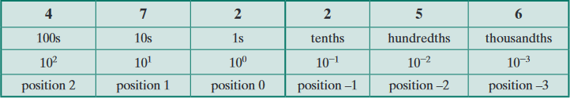
Decimal
A number with both an integer and fractional part has digits raised to both positive and negative powers of 10:
MSB
LSB

Slide 9
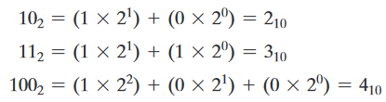
Binary
In the binary system, we have only two digits, 1 and 0. Thus, numbers in the binary system are represented to base 2.

Slide 10

Octal
In the octal system (radix 8). The eight symbols are 0, 1, 2, 3, 4, 5, 6, and 7.

Slide 11
Hexadecimal
hexadecimal (radix 16) , The 16 symbols of the hexadecimal system are 0, 1, 2, 3, 4, 5, 6, 7, 8, 9, A, B, C, 0, E, and F. The last six symbols are, unfortunately, identical to the letters of the alphabet and can cause confusion at times. However, this is the convention that has been adopted.

Slide 12
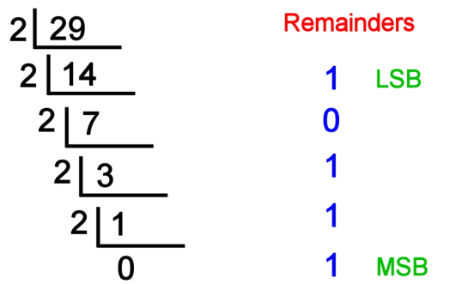
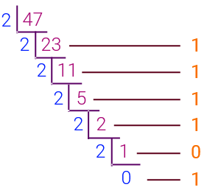

Decimal to Binary

Slide 13
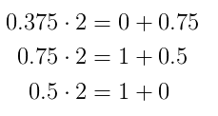
Converting decimal fraction to binary
Here is an example of such conversion using the fraction 0.375.
Multiplying with 2 until you get a resulting fractional part equal to zero.

Slide 14
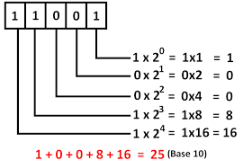
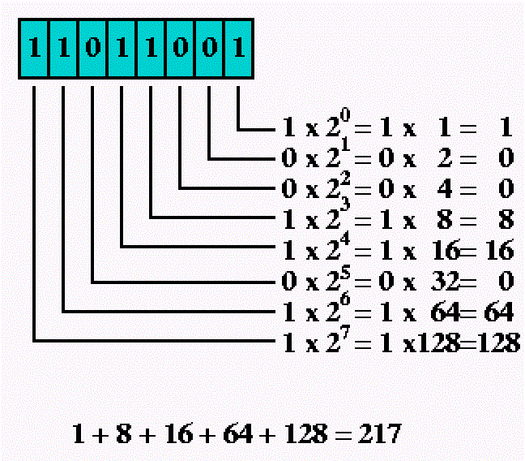
Binary to Decimal

Slide 15
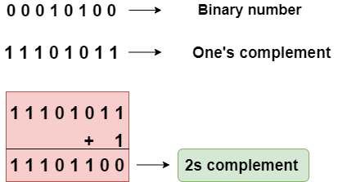
2’s complement

Slide 16
Register Transfer Language
The digital system modules are constructed from such digital components as register, decoders, arithmetic elements, and control logic.
Register holds some data and operations are performed on them (micro-operations like clear, load, shift etc..)
The symbolic notation used to describe the micro-operation transfers among registers is called a register transfer language.

Slide 17
Register Transfer Language
The term "register transfer" implies the availability of hardware logic circuits that can perform a stated micro operation, The word "language" is borrowed from programmers

Slide 18
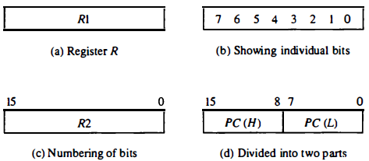
Register Transfer
Register can be represented as follows –

Slide 19
Register Transfer
Example of some registers –
Name | Working / Used for
MAR | Holds an address of memory unit
PC | Program counter
IR | Instruction register

Slide 20
Register Transfer
Destination
Source
R2 ← R1
a transfer of the content of register R1 into R2. And a replacement of the content of R2 by the content of R 1 . the content of the source register R1 does not change after the transfer

Slide 21
Register Transfer (predetermined condition)
If (P = 1) then (R2 ← R1)
transfer to occur only under a predetermined condition.

Slide 22
Register Transfer (Control function)
P: R2 ←R1
A control function (terminated with colon) is a Boolean variable that is equal to 1 or 0. It symbolizes the requirement that the transfer operation be executed by the hardware only if P = 1

Slide 23
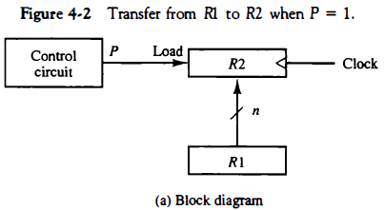
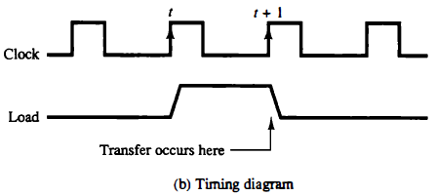

Slide 24
Register Transfer (Control function)
T: R2 ←R1, R1←R2
The arrow denotes a transfer of information and the direction of transfer. A comma is used to separate two or more operations that are executed at the same time

Slide 25
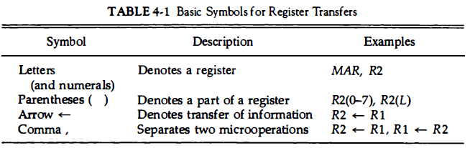
Register Transfer

Slide 26
Bus and Memory Transfers
Digital computers has many registers.
R1
R10
R2
R9
R3
R8
R4
R7
R5
R6

Slide 27
Bus and Memory Transfers
Digital computers has many registers.
Must have path for information transfer, one to another
Number of wires will be excessive if separate wires used.
Solution –
Using common bus system

Slide 28
Bus and Memory Transfers
Common Bus System - for transferring information between registers in a multiple-register configuration is a common bus system.
It consists of a set of common lines, one for each bit of a register, through which binary information is transferred one at a time.

Slide 29
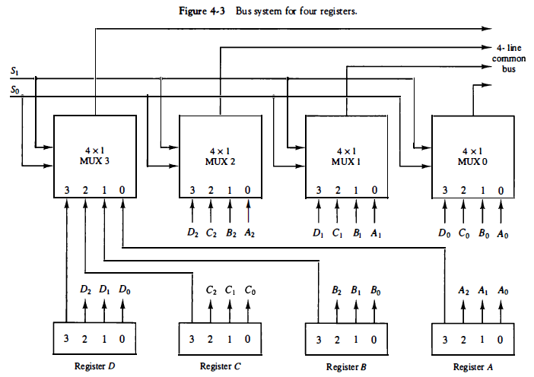
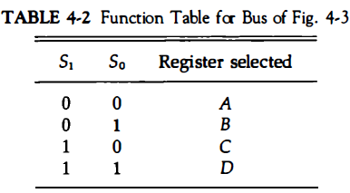
Common Bus System

Slide 30
Bus and Memory Transfers
Common Bus System - For example, a common bus for eight registers of 16 bits each requires 16 multiplexers, one for each line in the bus. Each multiplexer must have eight data input lines and three selection lines to multiplex one significant bit in the eight registers.

Slide 31
Three-State Bus Buffers
A bus system constructed with three-state gates instead of multiplexers, a digital circuit that exhibits three states.
Two of the states equivalent to logic 1 and 0 as in a conventional gate. The third state is a high-impedance state.
The high-impedance state behaves like an open circuit, means that the output is disconnected and does not have a logic significance. commonly used in the design of a bus system is the buffer gate.

Slide 32
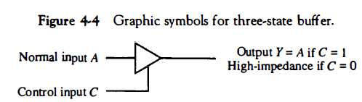
Three-State Bus Buffers

Slide 33
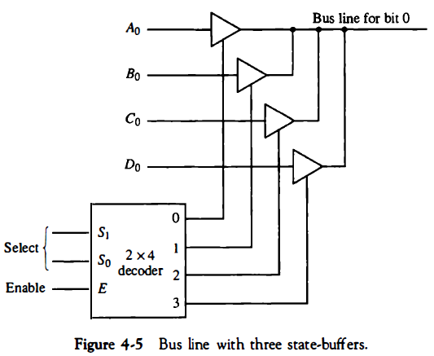
Three-State Bus Buffers

Slide 34
Memory Transfer
Read: DR ← M [AR]
Write: M [AR] ← DR

Slide 35
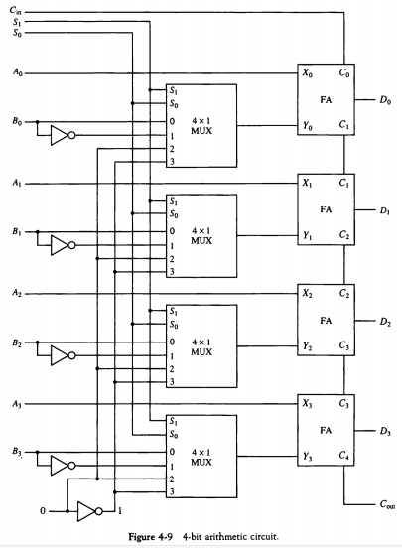
`

Slide 36
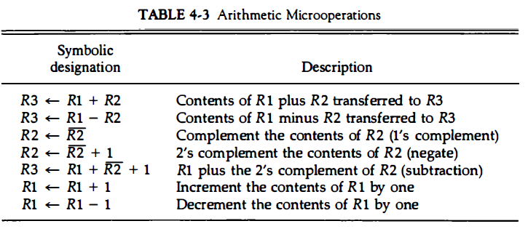
Arithmetic Microoperations

Slide 37
Binary Adder
To implement the add micro operation with hardware
The digital circuit that generates the arithmetic sum of two binary numbers of any length is called a binary adder.
The binary adder is constructed with full-adder, and does addition of 4 bit along with carry forward.

Slide 38
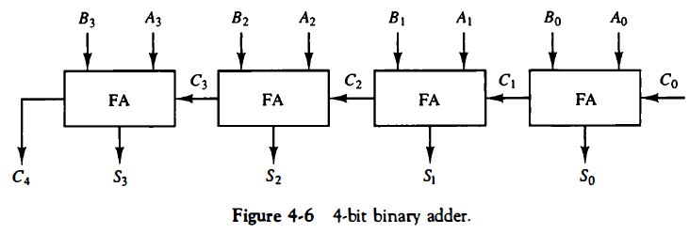
Binary Adder
Full-adder circuits, in cascade with the output carry from one full-adder connected to the input carry of the next full-adder.

Slide 39
Full-adder
Full Adder is the adder that adds three inputs and produces two outputs. The first two inputs are A and B and the third input is an input carry as C-IN.
The output carry is designated as C-OUT and the normal output is designated as S which is SUM.
A full adder logic is designed in such a manner that can take eight inputs together to create a byte-wide adder and cascade the carry bit from one adder to another.

Slide 40
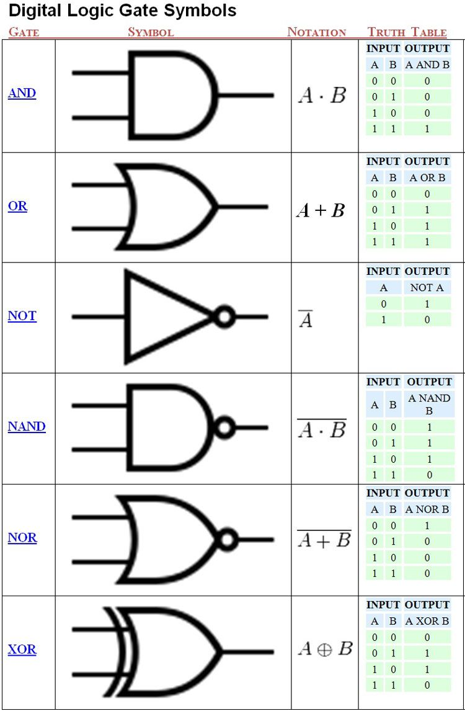

Slide 42
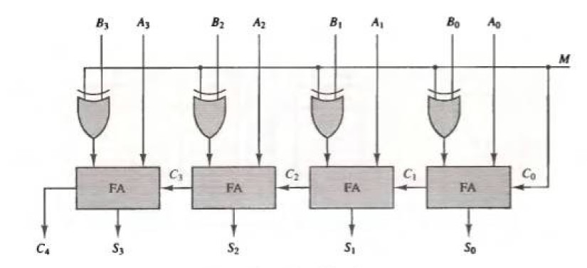
Binary Adder – Subtractor

Slide 43
Binary Adder – Subtractor
A Binary Adder-Subtractor is capable of both the addition and subtraction of binary numbers in one circuit itself.
The operation is performed depending on the binary value the control signal holds. It is one of the components of the ALU (Arithmetic Logic Unit).
This Circuit Requires prerequisite knowledge of Exor Gate, Binary Addition and Subtraction, and Full Adder.
The circuit consists of 4 full adders since we are performing operations on 4-bit numbers. There is a control line M that holds a binary value of either 0 or 1 which determines that the operation is carried out is addition or subtraction.

Slide 44
Binary Adder – Subtractor
when M=1, the operation being performed on the four-bit numbers is subtraction.
When M=0, the operation is performed on the four-bit numbers in addition.
Then C0 is serially passed to the second full adder as one of it’s outputs. The sum/difference S0 is recorded as the least significant bit of the sum/difference. A1, A2, A3 are direct inputs to the second, third and fourth full adders.

Slide 45
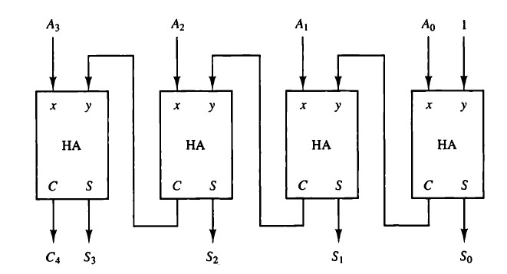
Binary Incrementer

